Slide 1
Door lock using Face detection authorization

Slide 2
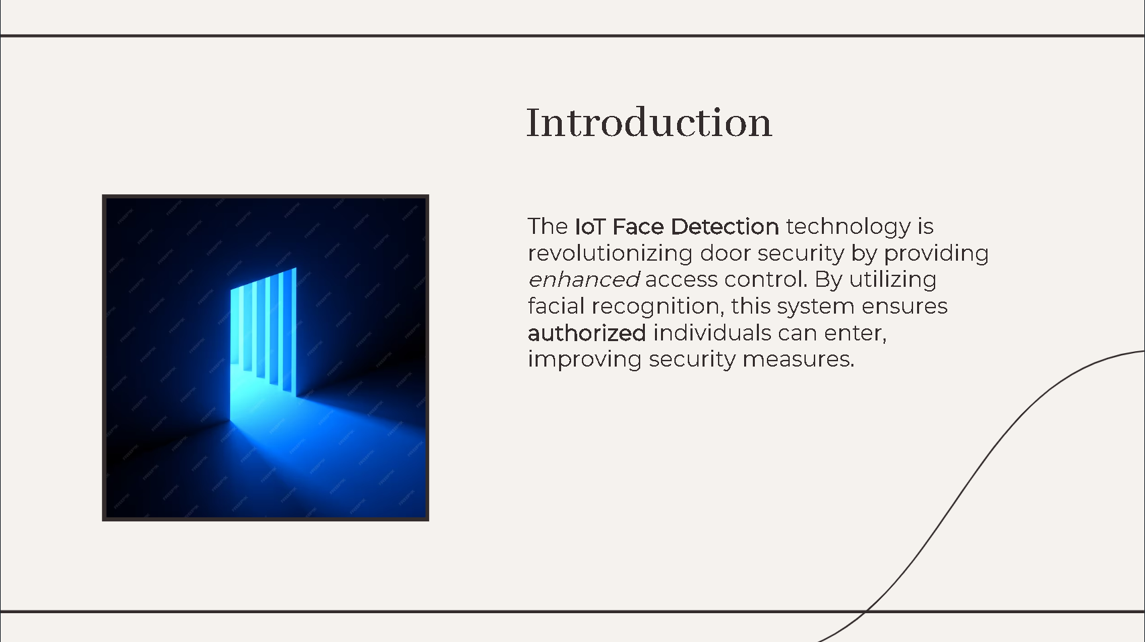

Slide 3
Parts used
Arduino uno
HC-05 Bluetooth module
12V door lock (Connected to a 5V relay)
LCD module 20X4 (connected to I2C serial adapted)
LED (Green and red)
Buzzer
12V power supply (used for Arduino and the relay)
Estimated price for the project ≈ 50JD

Slide 4
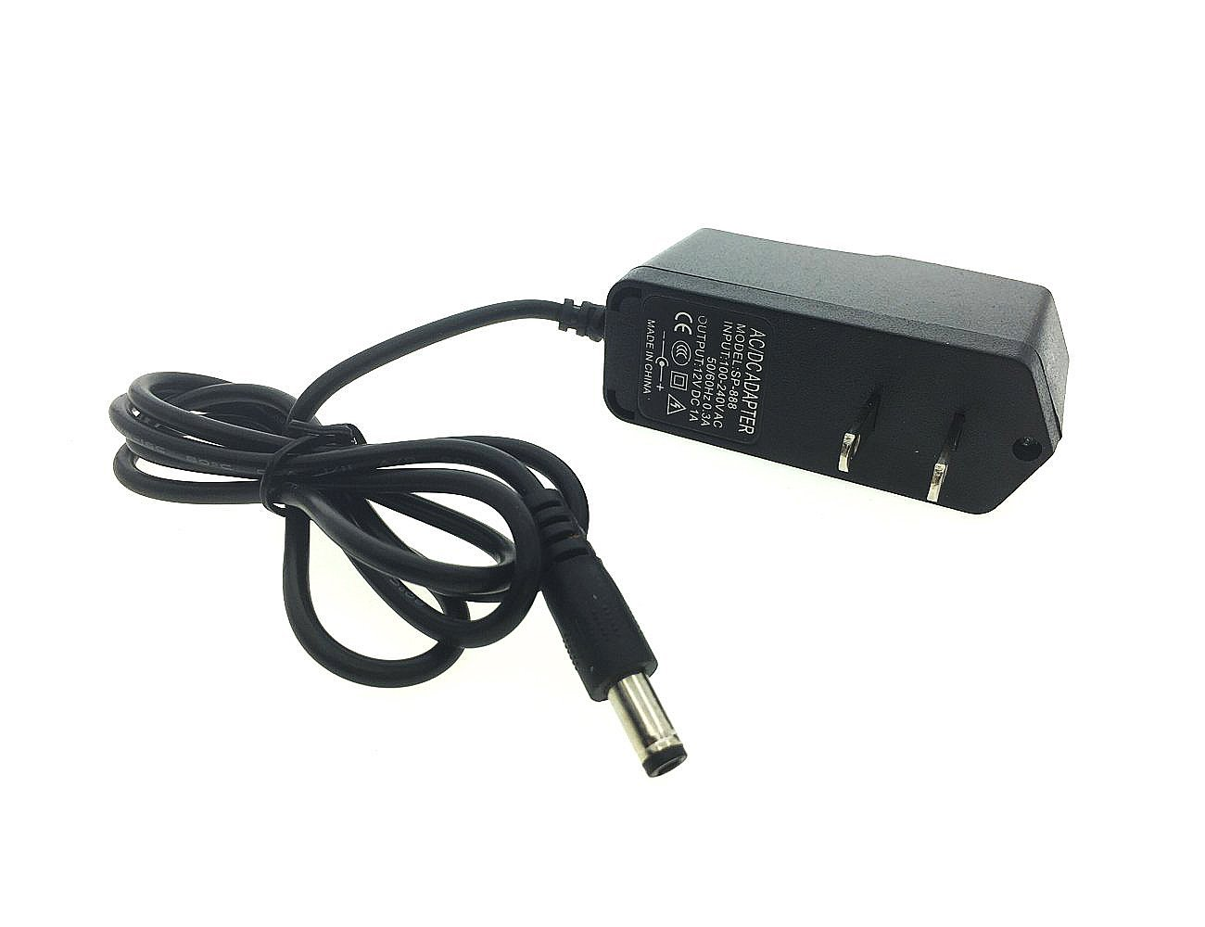
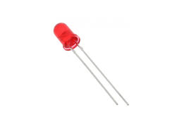
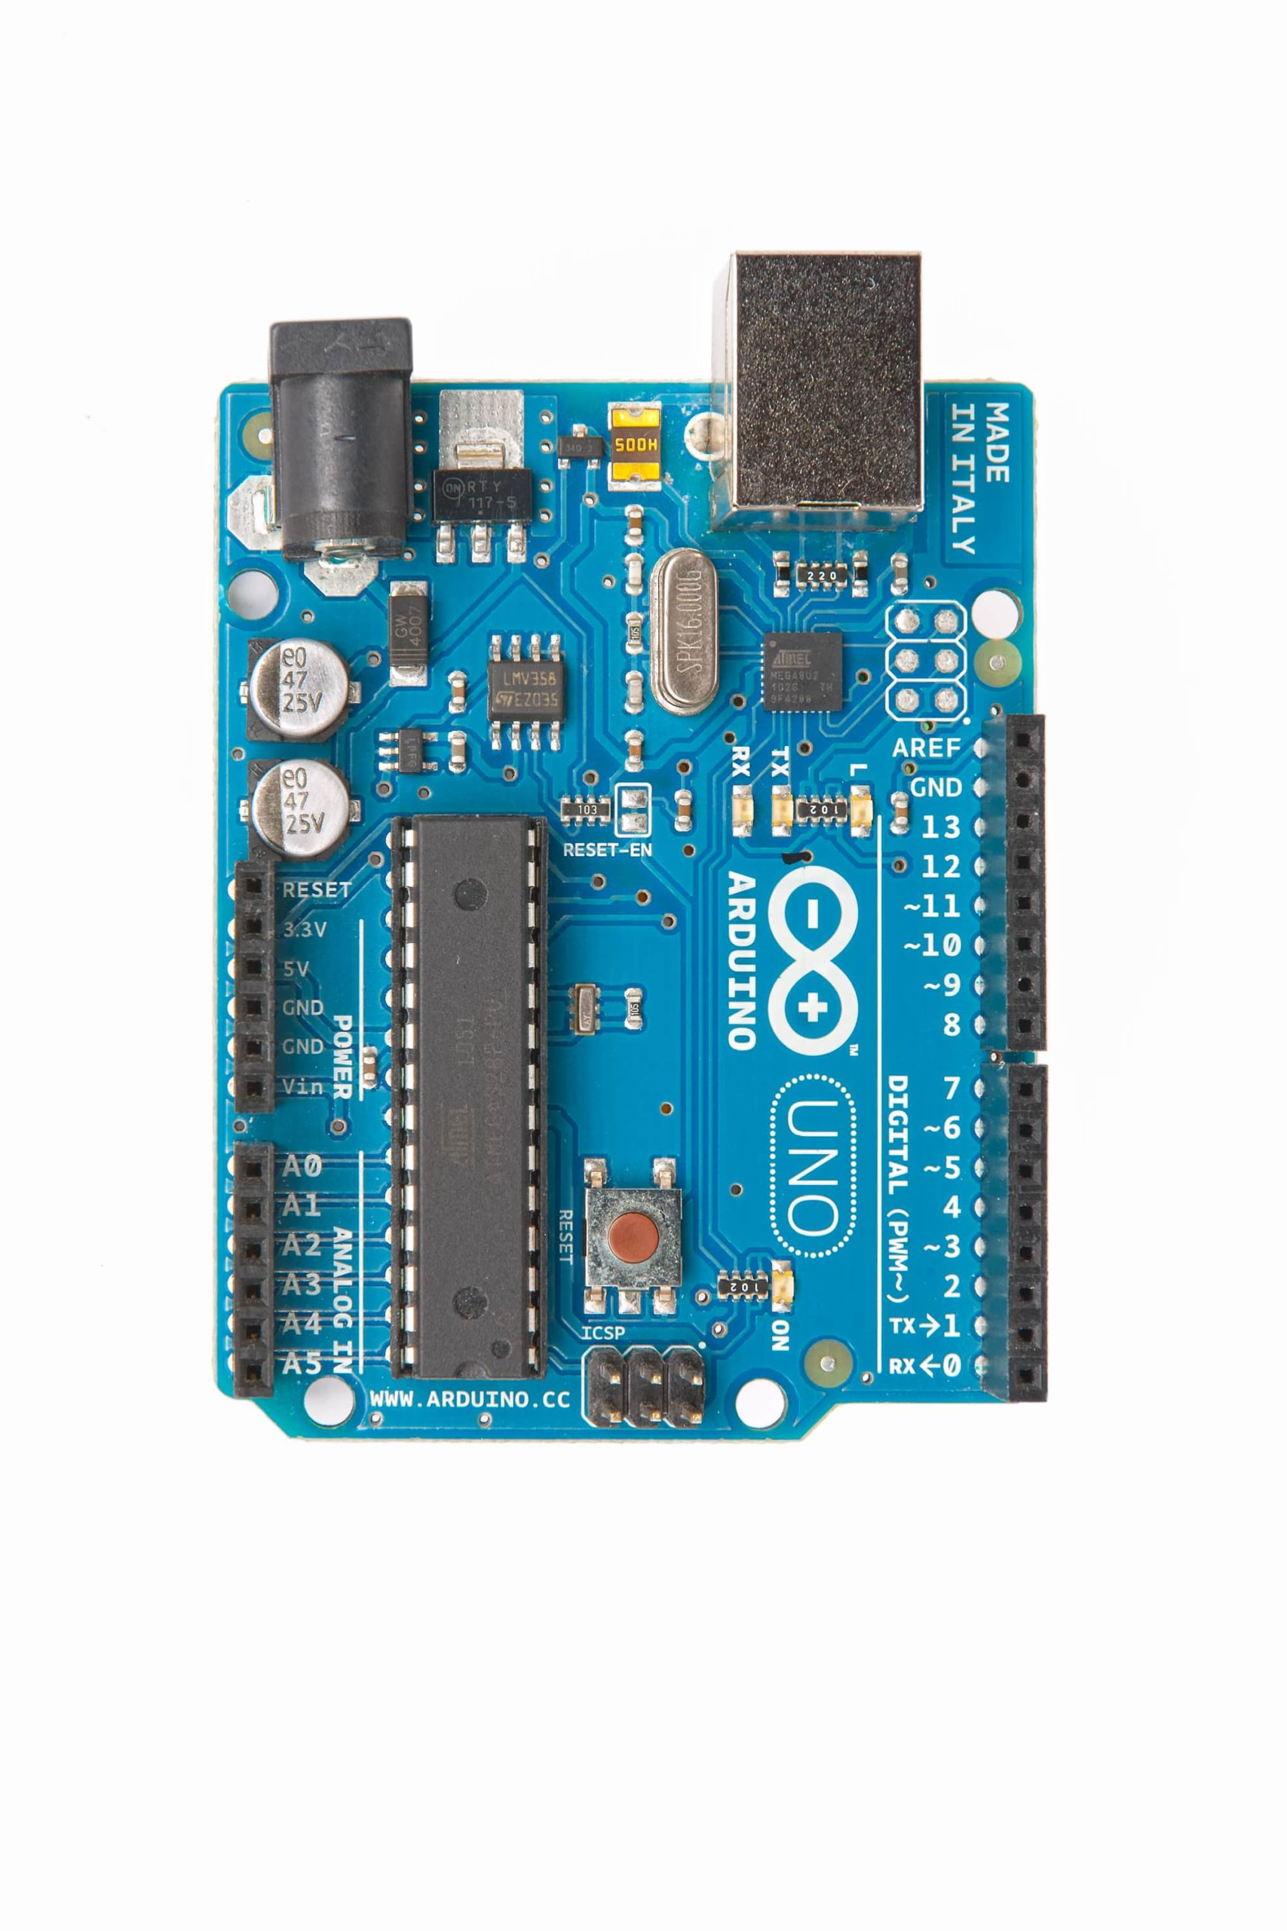
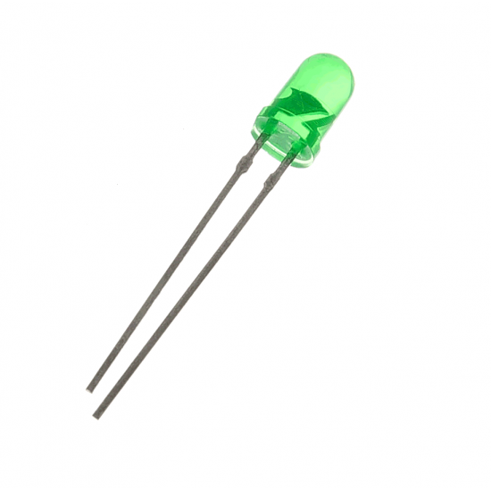
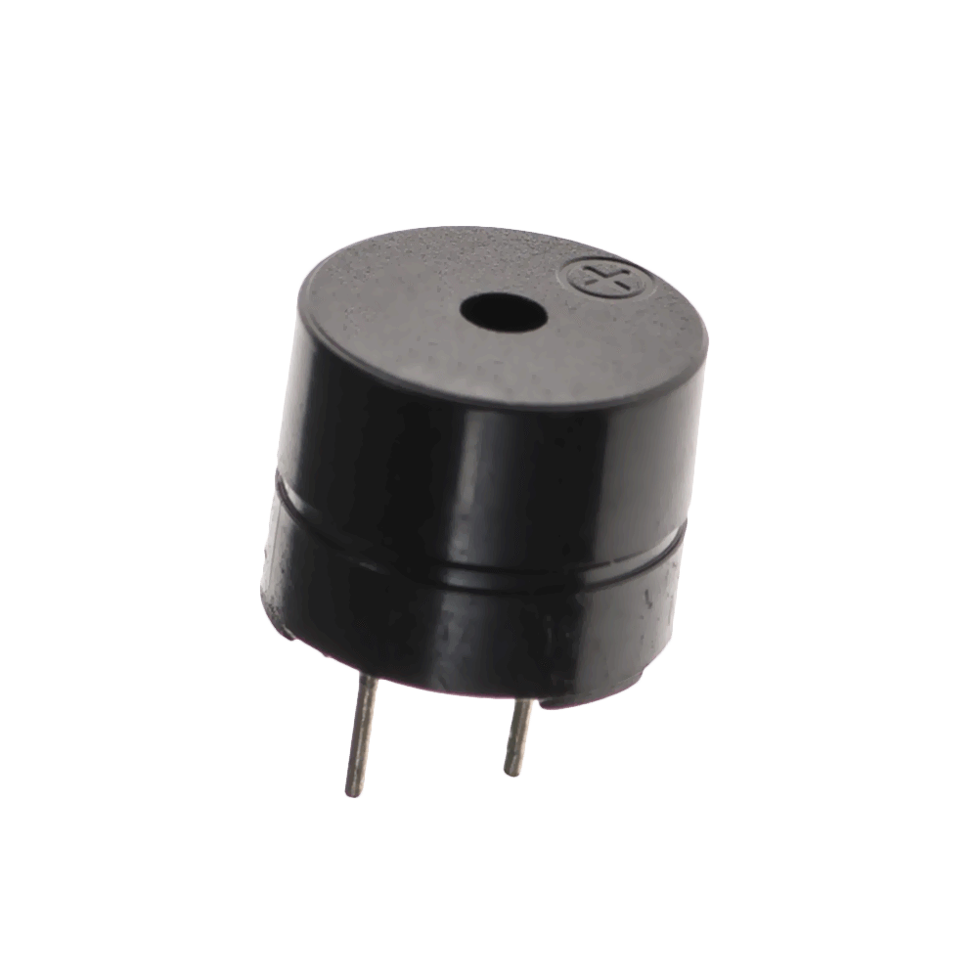
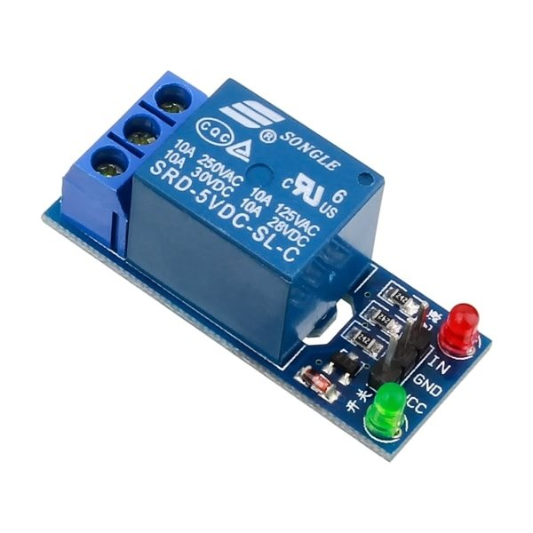
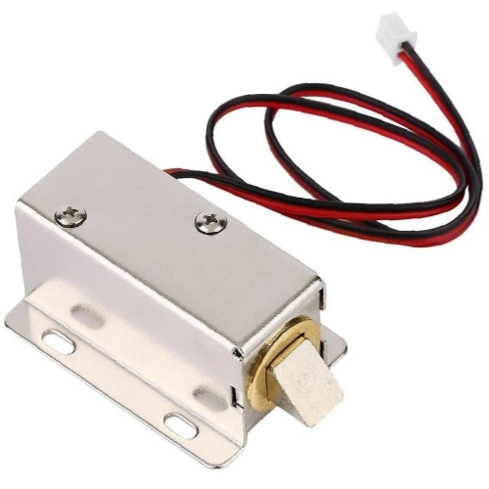
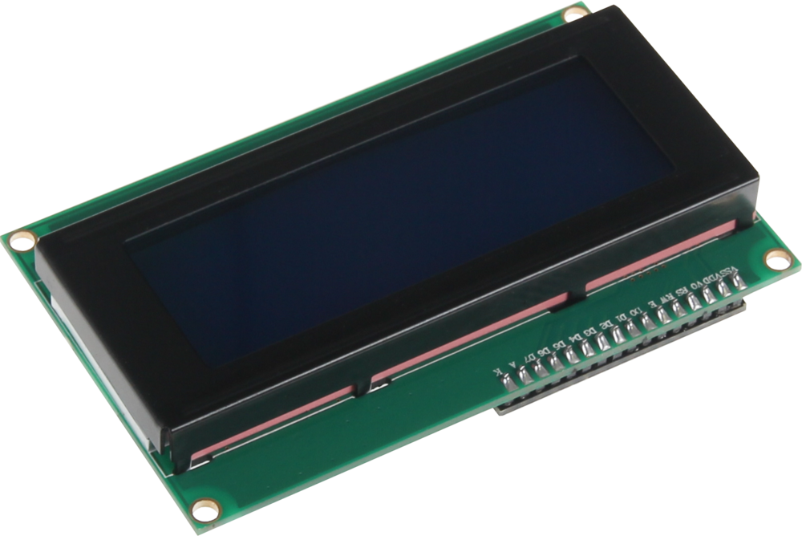
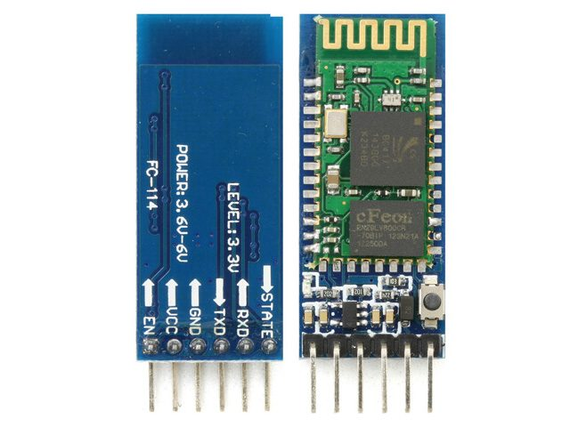
Arduino Pin Out
NO-> +
IN->D7
SDA->A4
TX->RX
SCL->A5
RX->TX

Slide 5
Tools used
PyCharm
OpenCV (cv2): Used for computer vision tasks
face_recognition
firebase_admin: A Python library to interact with Firebase service
serial: Used for serial communication with Arduino over Bluetooth.
Arduino IDE
Google Firebase
Node-RED
IV cam

Slide 6
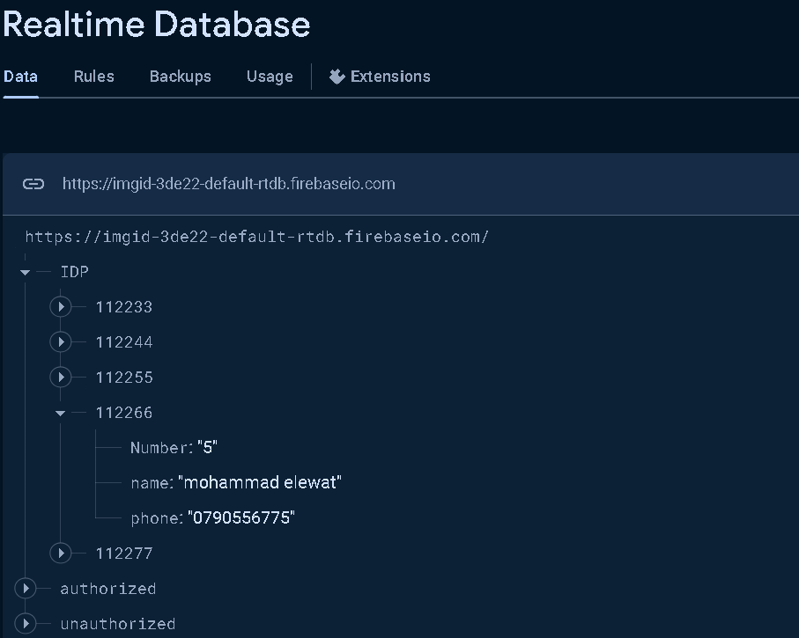
Tools used : google firebase
IDP, authorized and unauthorized are called parent nodes(tables)
And in each one of them we have the child nodes(columns)

Slide 7
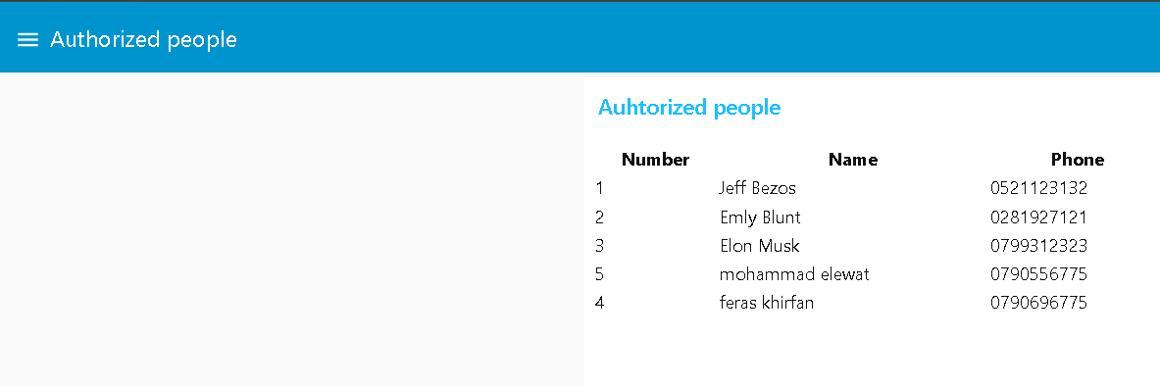
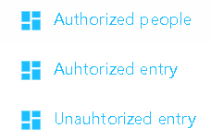
Tools used : Node-RED
For each table in firebase we have a tab in node-Red to visualize it
To make it easier to the security (or any authorized person) to access this data.

Slide 8
AI used
Feature Extraction with DL.
Recognition and Classification with DL.
Machine Learning (ML) for Image Processing.

Slide 9
Project uses for our field
Giving access to students and any authorized person in a certain time to enter the classroom.
Also, can be used for automating class attendance by connecting it to the eLearning.

Slide 10
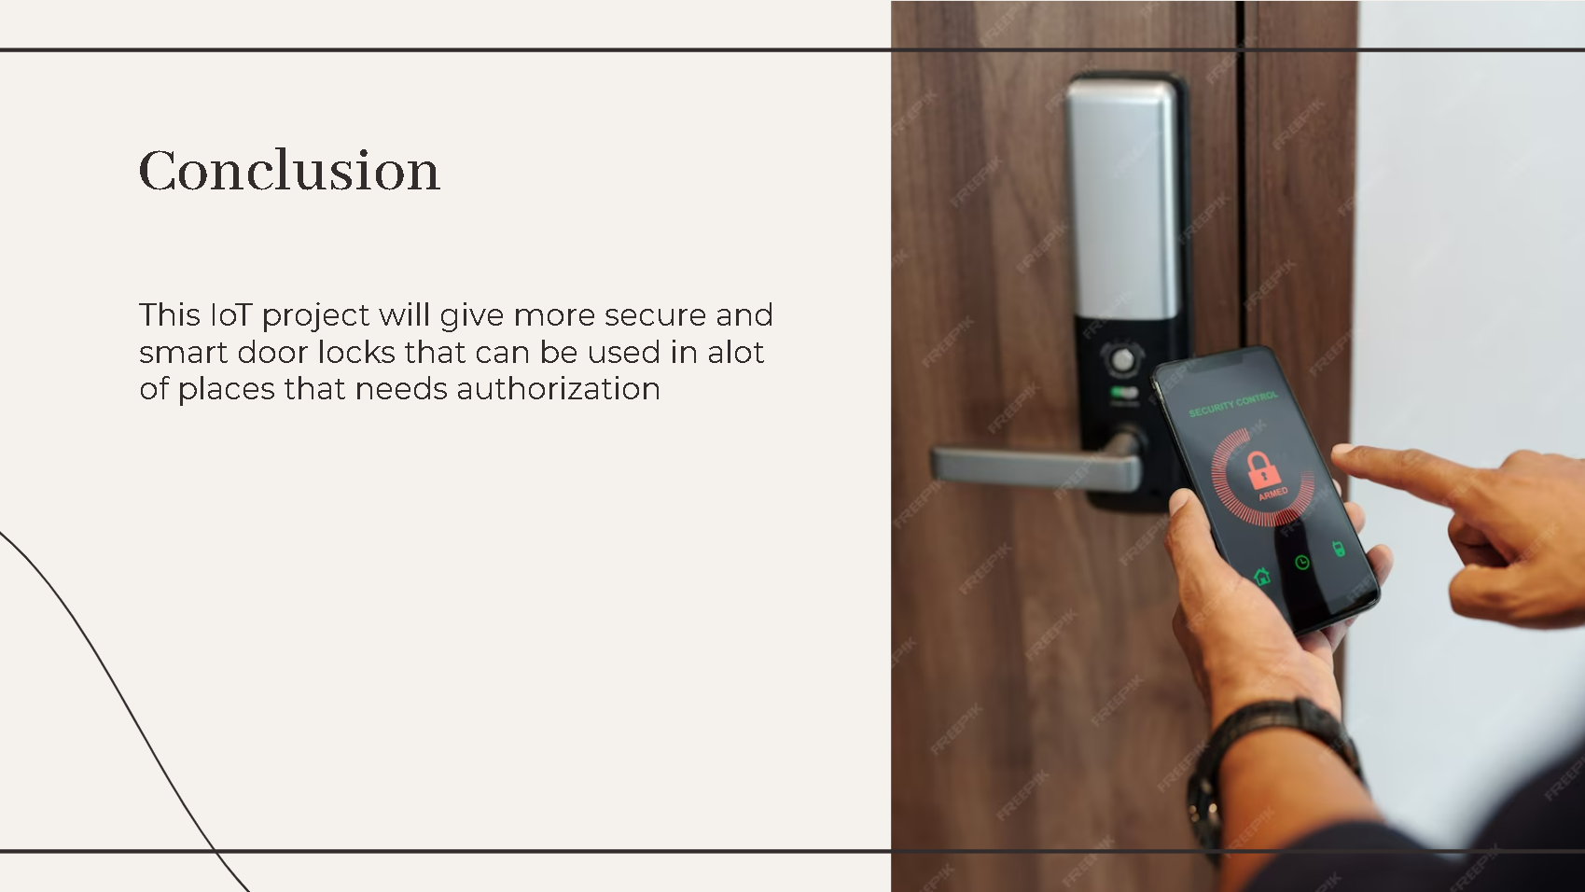

Slide 11


